Slide 1
Software Quality Recipes for Legacy .NET Applications
Matt Eland
@IntegerMan
https://www.Linkedin.com/in/MattEland/
Slides and code available at: https://GitHub.com/IntegerMan/SoftwareQualityTalk/

Slide 2
About Me
.NET / TypeScript / Angular Developer turned Manager / Mentor
Programming
For fun since 1987
.NET since 2001 (Beta 2)
Professionally since 2006
Addicted to Reading and Refactoring

Slide 3
My Background
Currently:
Software Engineering Manager at MoveHQ (1 year)
Previously:
Senior Software Engineer at TeamDynamix (9 years)
Software Developer at Exceptional Innovation (3 years)
Software Engineer at Verizon Business (6 months)

Slide 4
About This Talk
Intended to introduce variety of tools and ideas to give you options when working with legacy code
Primer on Unit Testing in C#
.NET Libraries useful for improving tests
Other Testing Techniques
Quality Analysis Primer

Slide 5

This Talk Is NOT
Focused on any particular .NET project type
ASP .NET, XAML, Web API etc
Focused extensively on any one library or tool
Code-Intensive
Solely about unit testing
403 FORBIDDEN

Slide 6
Example Codebase: Resume Scoring Algorithm
Resume Information
System
Under Test
Resume Score

Slide 7
A Primer on Software Testing

Slide 8
Types of Tests
Integration Tests
Manual
Unit / Component Tests
UI Automation
Exploratory

Slide 9
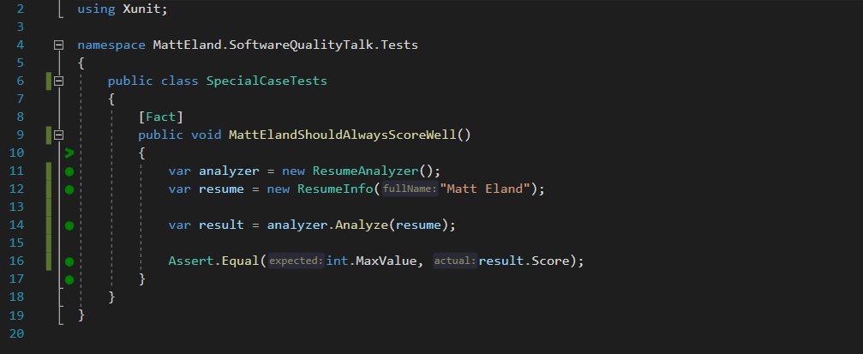
What is a Unit Test?

Slide 10
What is a Unit Test? – Detected by Attribute

Slide 11
What is a Unit Test? – Exercises System Under Test

Slide 12
What is a Unit Test? – Contains Assertions

Slide 13
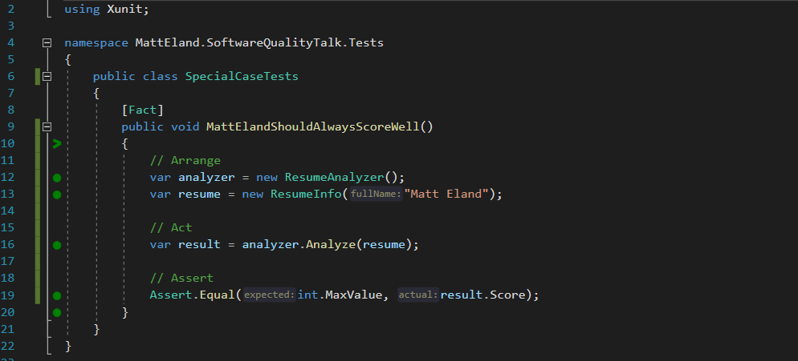
What is a Unit Test? – Arrange / Act / Assert

Slide 14
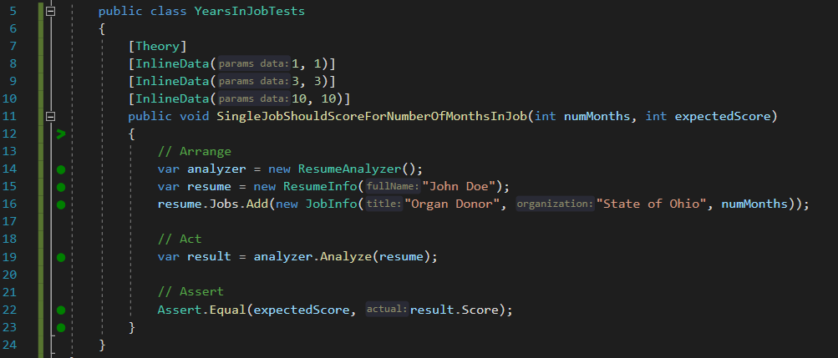
Parameterized Unit Tests

Slide 15



Unit Testing Frameworks
MSTest
NUnit
XUnit
Already installed in Visual Studio
[TestMethod] / [DataTestMethod]
MSTest2 closes gaps the original had
Port of frameworks like Junit
[Test] / [TestCase]
Often more integration support
More recent addition
[Fact] / [Theory]
More favored in .NET Core applications
See https://raygun.com/blog/unit-testing-frameworks-c/ for detailed analysis of different frameworks

Slide 16
Test Driven Development (TDD)
Green
Clean up System Under Test
Red
Write a failing test
Make the test pass
Refactor

Slide 17

But I can’t test my code because _______________ !

Slide 18
But I can’t test my code because _______________ !
it works with the UI
Some options:
Then don’t write tests for it.
Make the view layer as small and dumb as possible, then test the rest
Selenium tests for web / Coded UI tests for desktop

Slide 19
But I can’t test my code because _______________ !
Database Dependencies
Some options:
Remove the database dependency via Dependency Injection
Use Entity Framework and in-memory database tests
Keep talking to the database, but work around the limitation

Slide 20
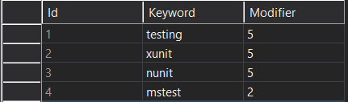
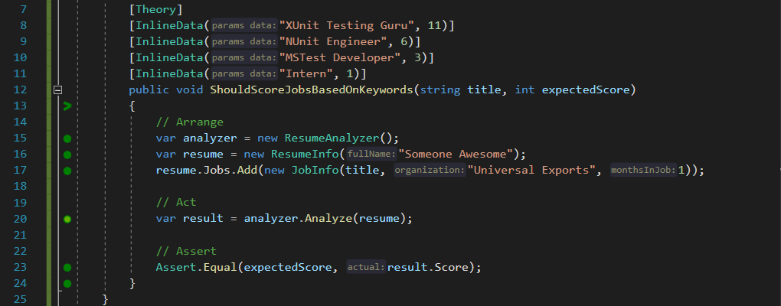
Removing Database Dependencies Example

Slide 21
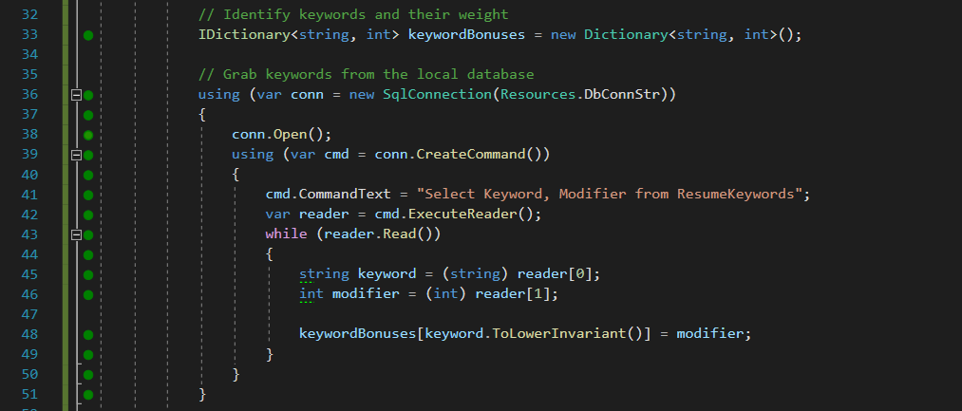
Removing Database Dependencies Example

Slide 22
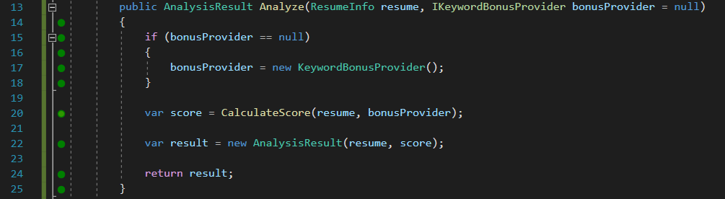
Removing Database Dependencies Example

Slide 23
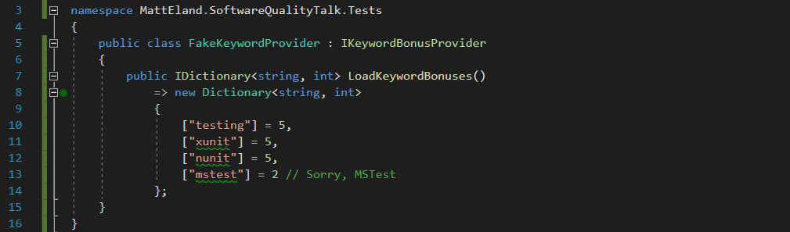
Removing Database Dependencies Example

Slide 24
But I can’t test my code because _______________ !
it’s a big ball of mud
Some options:
Git Gud
Don’t test, but expect bugs in the legacy system when changes arise
Place some “pinning” tests, then refactor to a better architecture

Slide 25
Testing Libraries

Slide 26
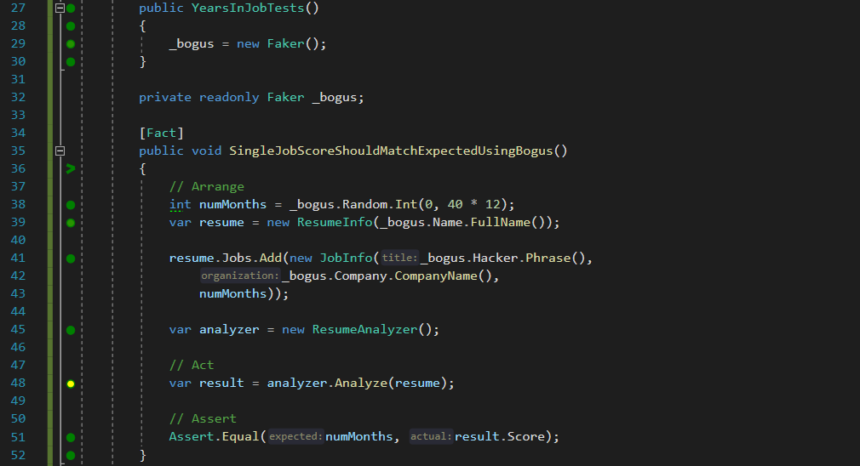
Generating Test Data with Bogus
GitHub Repo: https://github.com/bchavez/Bogus

Slide 27
Shouldly / FluentAsserts

Slide 28
Behavior Driven Development with SpecFlow

Slide 29
Comparing Logic with Scientist .NET

Slide 30
Testing State Trees with SnapShotter / ApprovalTests / Snapper

Slide 31
Moq to Create Mock Objects

Slide 32
Moq to Verify Behavior

Slide 33
AutoFixture

Slide 34
Finding Edge Cases with SharpFuzz

Slide 35
In Memory Tests with EntityFramework

Slide 36
Other Recipes

Slide 37
User Interface Testing
Selinium
Katalon Recorder

Slide 38
Code Reviews

Slide 39
Code Analysis

Slide 40
Postman Collections For API Testing

Slide 41
Test Plans

Slide 42
Testing & CI/CD Pipelines

Slide 43
JetBrains Annotations / Code Contracts

Slide 44
Functional Programming

Slide 45
NCrunch

Slide 46
Defect Analysis

Slide 47
Tabulating Data

Slide 48
Defects by Type

Slide 49
New Defects by Root Cause

Slide 50
Defects by Area

Slide 51
Conclusion
Slides and code available at: https://GitHub.com/IntegerMan/SoftwareQualityTalk/

Slide 52
Key Takeaways
Slides and code available at: https://GitHub.com/IntegerMan/SoftwareQualityTalk/

Slide 53
Book Recommendations
Working Effectively with Legacy Code
XUnit Test Patterns
Measuring the Software Process
Developer Testing
Slides and code available at: https://GitHub.com/IntegerMan/SoftwareQualityTalk/

Slide 54
Questions? Other Quality Recipes?
Slides and code available at: https://GitHub.com/IntegerMan/SoftwareQualityTalk/

